Slide 1

Improving Patient Length of Stay
Ellie Goodman

Slide 2

Agenda
Problem Overview
Objective of Analysis
Project Timeline
Assumptions, Challenges, & Risks
Results & Findings
Methodology
Recommendations
Outcomes & Takeaways
Exploratory Analysis Tools

Slide 3
UIHC Problem Overview
Who: University of Iowa's Hospitals and Clinics
What: Patient length of stay
How: Create a dashboard in Slicer Dicer using Epic
Why:
Extended length of patient stays throughout the University of Iowa facilities
Discover underlying variables that affect extended stay
Create simple and easy to read dashboards for the UIHC doctors and nurses
Analyze departments with extended stays based off patient data

Slide 4
Importance of Patient Length of Stay
UIHC average patient length of stay (LOS): 6.8 days
National average patient length of stay (GMLOS): 4.5 days
Creation of bed shortages
Contamination of illnesses
Increase of costs & inefficiency
Disruption of patient flow
Overworked nurses & doctors

Slide 5
Objective of Analysis
Find underlying variables relating to patient length of stay
Create an informative dashboard to analyze findings

Slide 6


Exploratory Analysis Tools
Epic
Main electronic health record system used at many hospitals, specifically the University of Iowa's hospitals and clinics
Includes all patient medical history and records
Allows all clinical information to be stored in one convenient and secure database
Slicer Dicer
Data exploration tool within Epic that allows customization abilities to explore patient history and data
Provides physicians, department managers, and other users with intuitive and customizable data exploration abilities
All patient data found within Slicer Dicer comes from Epic

Slide 7
Project Timeline
Focus on Project Background to Create a Strong Foundation
Create Intuitive Visuals in Slicer Dicer using Epic
Create an effective and informative dashboard in Slicer Dicer to present our analysis
Understand underlying problems affecting patient length of stay throughout the hospitals and clinics
Learn exploratory analysis tools: Epic and Slicer Dicer
Build 6-8 different visuals such as tables, models, and graphs
Understand Underlying Variables Affecting Extended Patient Length of Stay
Analyze and interpret measures, values, and patient variables
Observe trends, patterns, and outliers of current patient statistics as well as patient history

Slide 8



Assumptions
Average length of stay is around 3 days
Older patients will be the focus of extended length of stay
Emergency Department receives the most visits

Slide 9
Challenges & Risks
Analyzing private and personal patient information
Data breaches
Patient medical records being leaked or deleted
Challenge #1: Choosing most important patient variables to find correlation between patient length of stay
Challenge #2: Different visualization options to display information on project dashboard
Challenge #3: Analyzing significant variables in relation to group recommendations

Slide 10
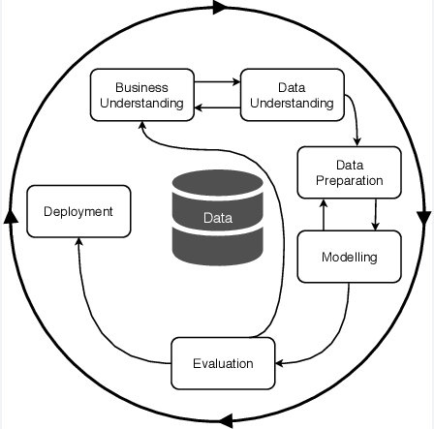
Methodology
CROSS INDUSTRY STANDARD PROCESS FOR DATA MINING (CRISP-DM MODEL)

Slide 11
Business Understanding
Analyze underlying variables affecting patient length of stay
Determine which departments have the longest inpatient stays
Assist UIHC nurses and doctors in creating intuitive and accessible dashboards
Help the University of Iowa's facilities leverage data analysis regarding extended patient stays

Slide 12
Data Understanding
Focusing on past 6 months
Understanding of recent trends
Rapidly changing environment
Analysis includes current patient statistics, demographics, & medical history
LOS>GMLOS: where length of stay at UIHC is greater than the geometric mean length of stay

Slide 13
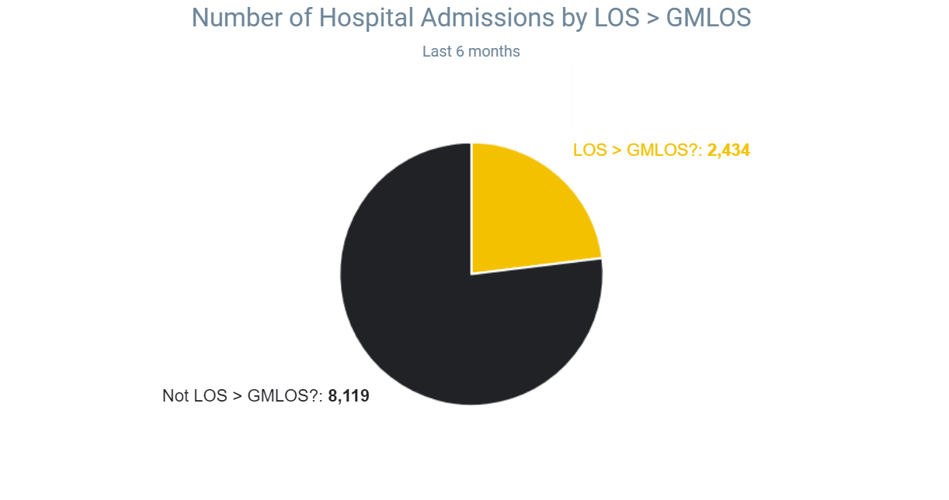
23%
77%

Slide 14
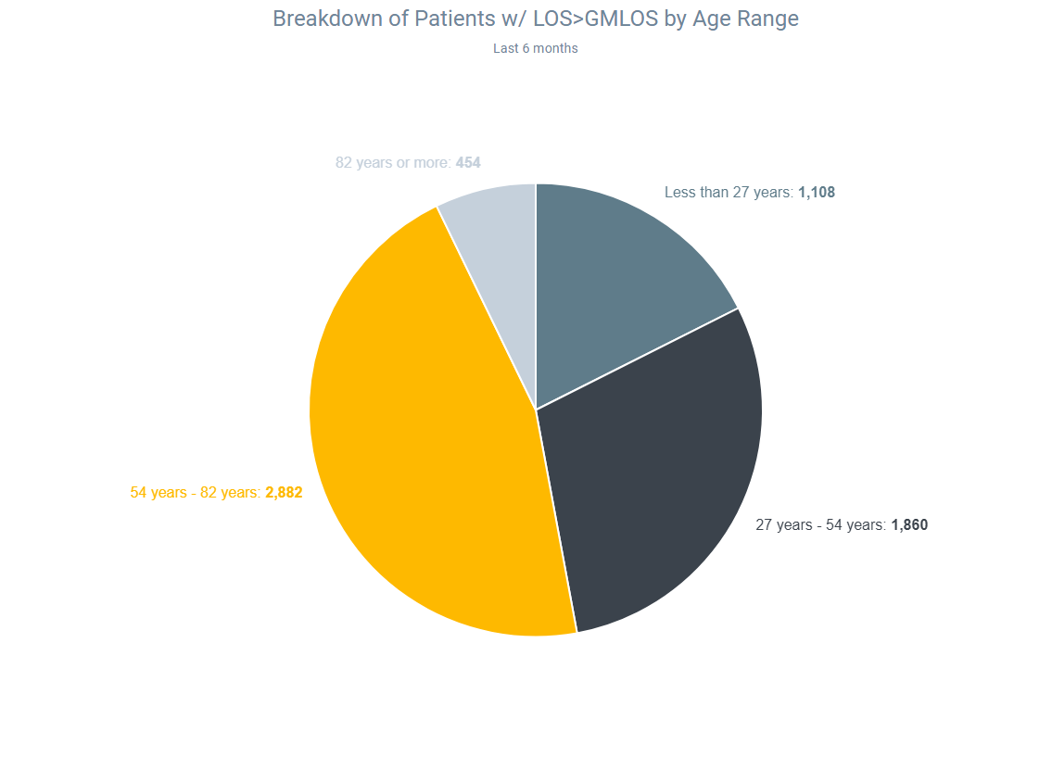
7.2%
17.6%
45.7%
29.5%

Slide 15
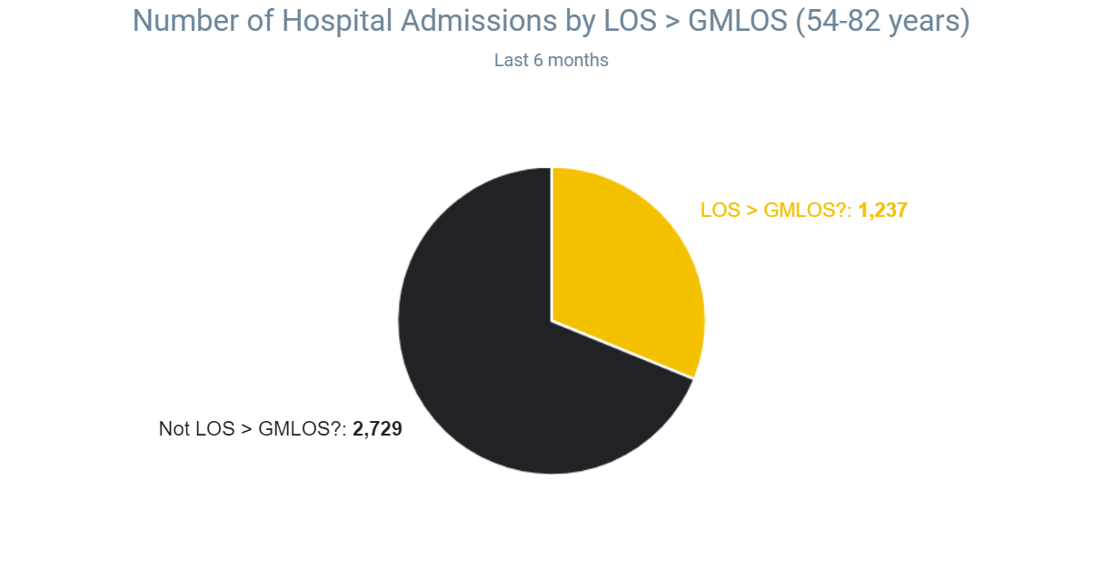
31%
69%

Slide 16
Data Preparation
Understand all measures and values in Slicer Dicer
Narrow analysis focus on significant variables
Filter patient population based on dashboard visual findings
As we are working with real-life patient information, our data preparation of our length of stay analysis did not incorporate any cleaning, transformation, or deletion of data.

Slide 17
Modeling
Age
Department
Pre-Existing Conditions
Hospital Admissions
Percent of Patients by Quarter

Slide 18
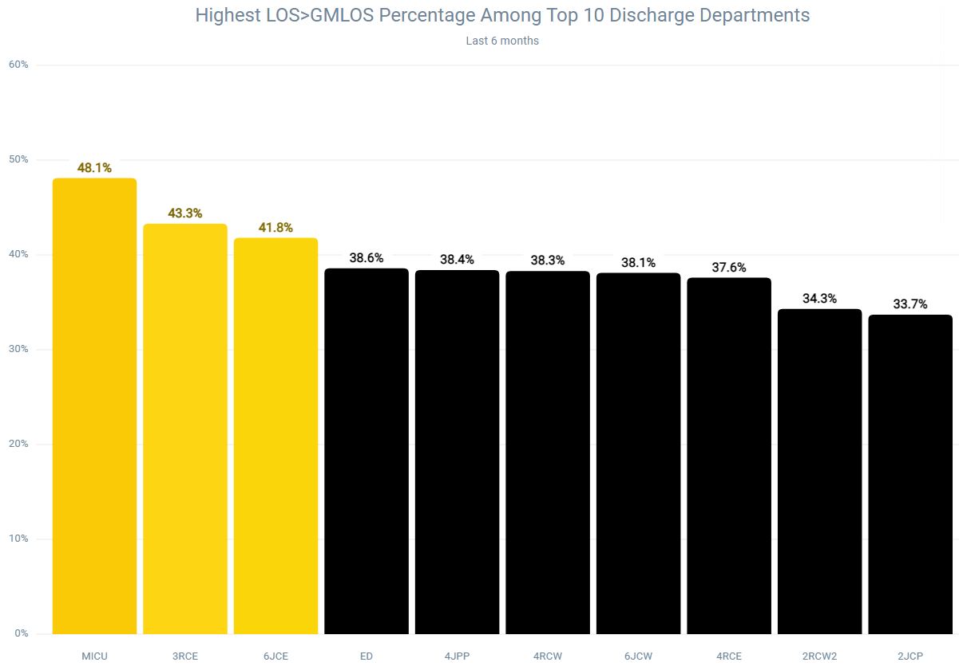

Slide 19
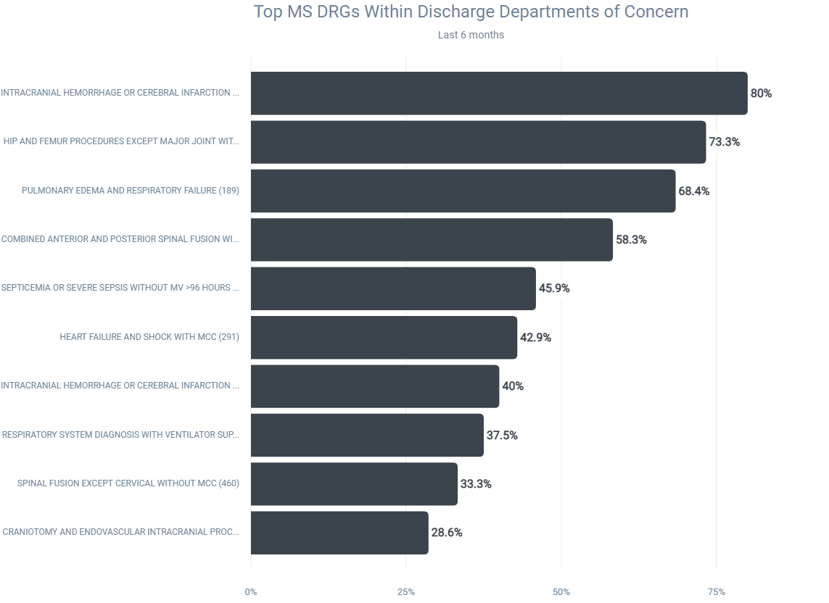

Slide 20
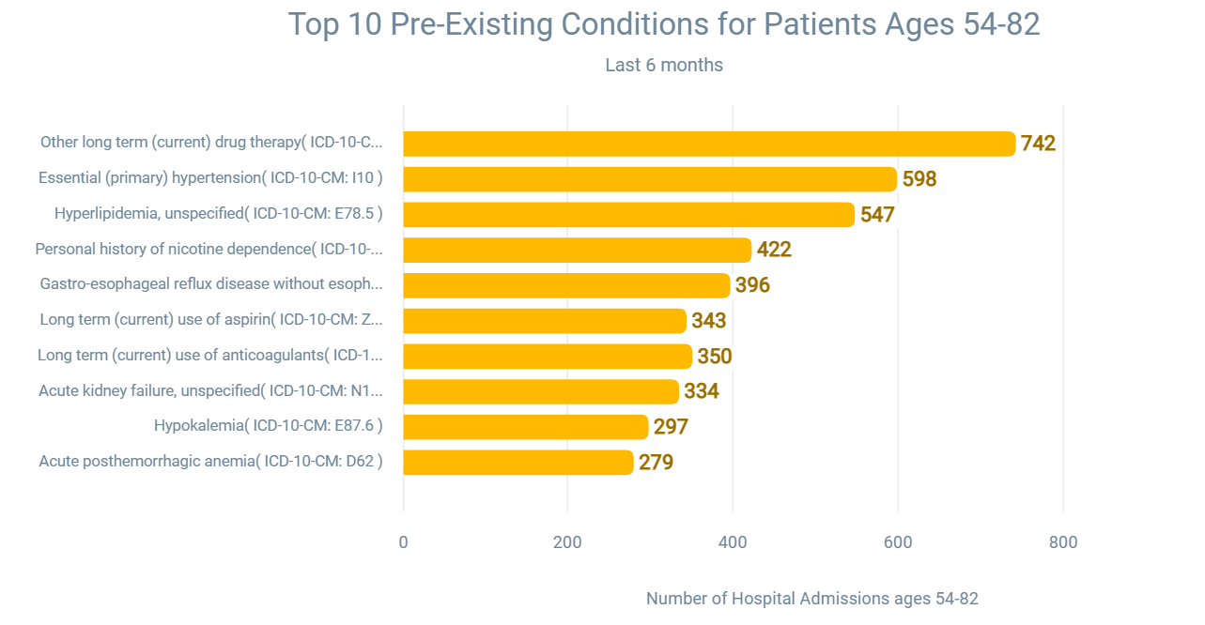

Slide 21
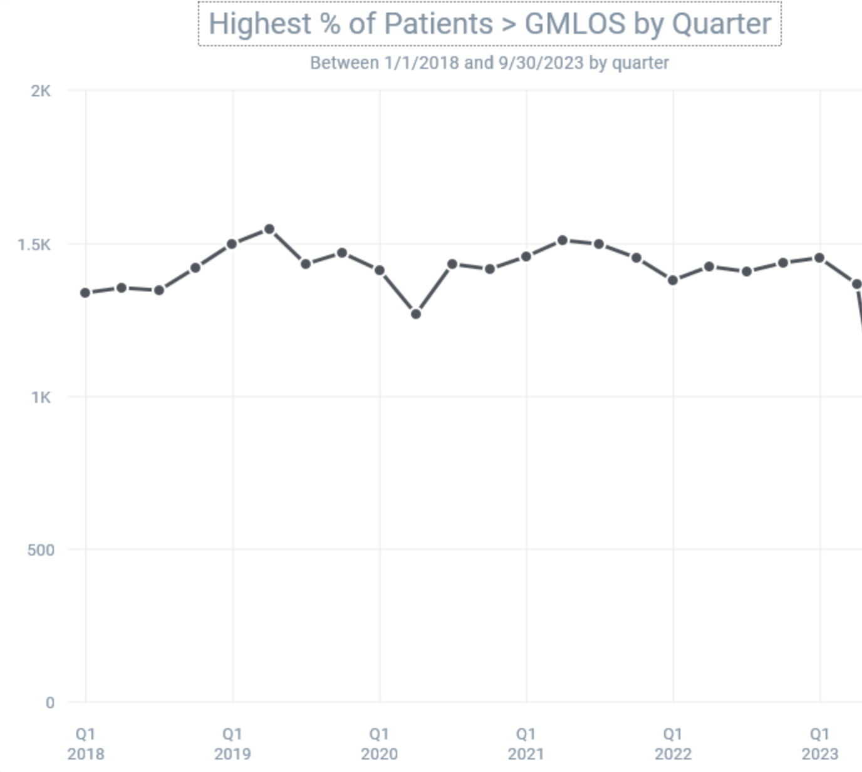

Slide 22
Evaluation
Over the past 6 months, 23% of patients have exceeded the GMLOS
31% of patients ages 54-82 years old have a LOS>GMLOS
Medical Intensive Care Unit (MICU) is the top discharge department of patients ages 54-82 with LOS>GMLOS
Treatment by medication (drug therapy) is the most common pre-existing condition for patients ages 54-82
There has been a steady percentage of patients with extended stays greater than GMLOS since 2018

Slide 23
Recommendations & Deployment
Hospital structure
Overstaffing departments
Collaborative care coordination
Data driven decisions

Slide 24
Outcomes & Takeaways
Patient information can be inconsistent and unpredictable
Data cleaning solutions are unique to the problem at hand
Communication is vital to succeed

